Slide 1
Effect of the environment on gene expression

Slide 2
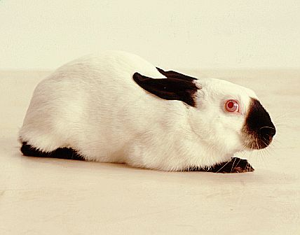
Temperature
Can affect enzymes systems.
  E.g. Himalayan rabbits – colour gene not expressed in warmer areas

Slide 3
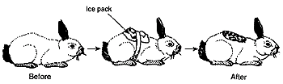
Just to prove the point

Slide 4
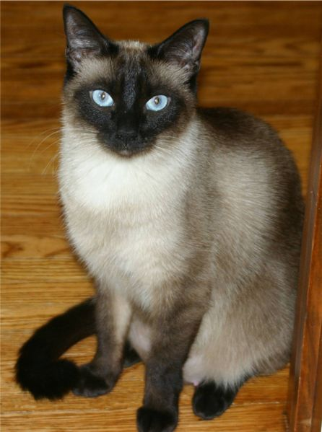
Same with siamese cats

Slide 5
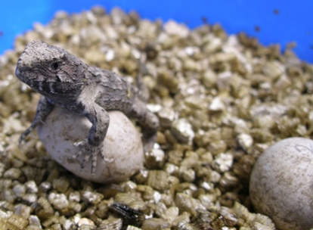
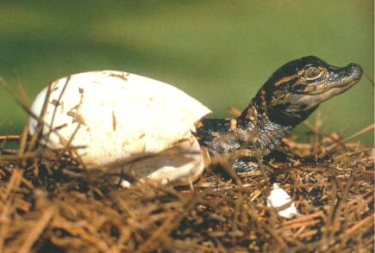
Reptiles
Sex is determined by temperature of incubation of eggs
At 18° tuatara eggs develop into females.
At 22° they develop into males
Similar effects occur in some alligators.

Slide 6
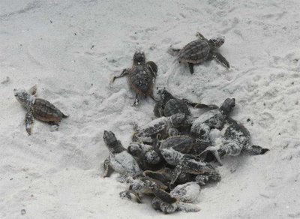
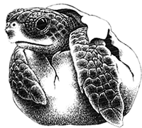
In most turtles it is opposite.
Within a narrow range of temperatures (centred at 28 °C) a clutch of eggs yields nearly equal numbers of females and males.
Above that range all hatchlings are female, and below it all are male.

Slide 7
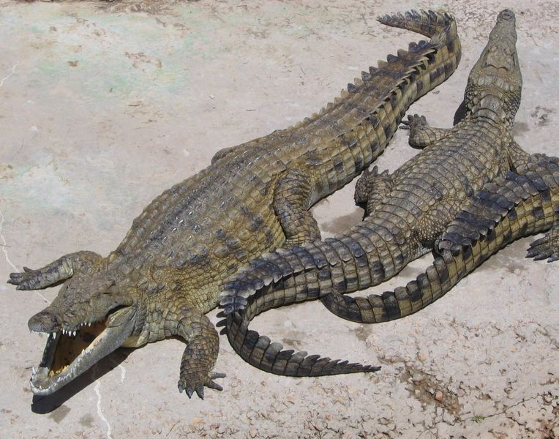
Nile crocodile
Eggs incubated below 31.7°C – females
Between 31.7°C and 34.5°C – males
Above 34.5°C - females

Slide 8
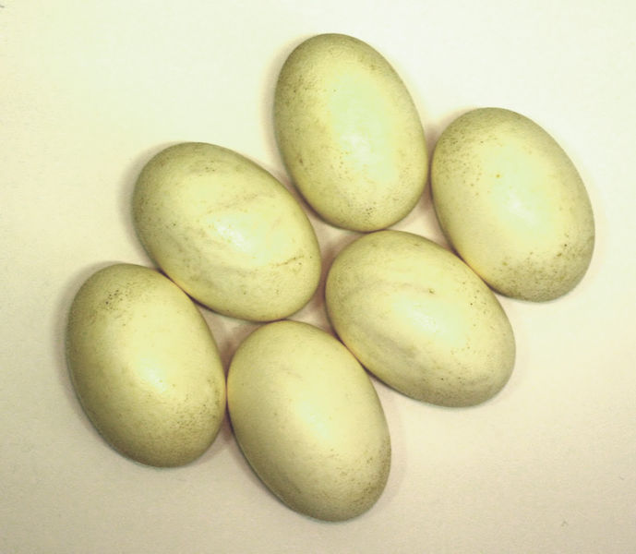
Croc eggs

Slide 9
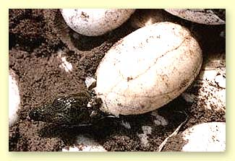
Son or daughter?

Slide 10

Crikey!

Slide 11
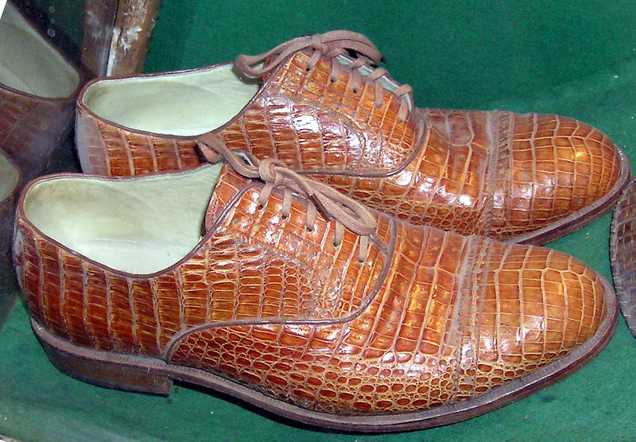
Crocodile shoes

Slide 12
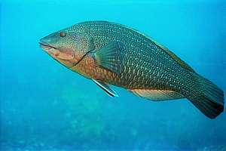
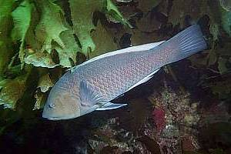
Effect of other gender on Fish
Some cleaner fish live in groups with only one male. If he dies, the most dominant female changes into a male.
Female green wrasse Male

Slide 13
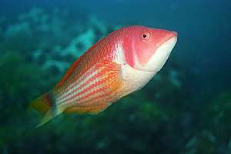
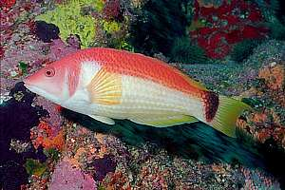
A female scarlet wrasse turning into a male
Male

Slide 14
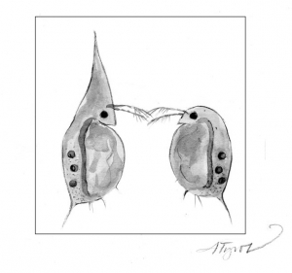
Daphnia (“water fleas”)
Grow a spiny “helmet” in summer. This may be in response to the presence of predators
Summer
fashion
Winter outfit

Slide 15
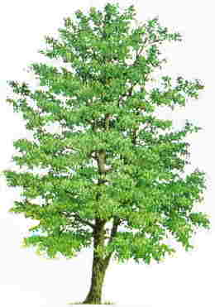
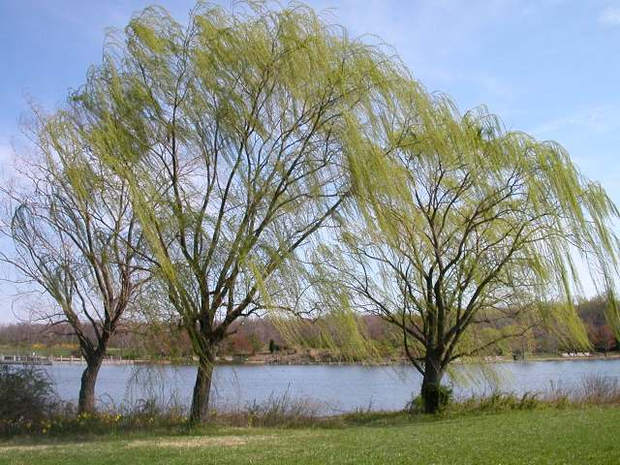
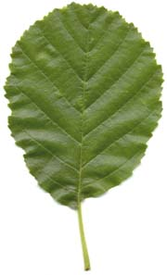
Willows and alders produce anti-herbivore toxins when attacked AND warn neighbours of insect attack
Alder
Thanks dude!
Willow
Hey mate!
Watch out!
Alder leaf

Slide 16
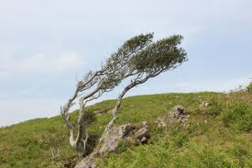
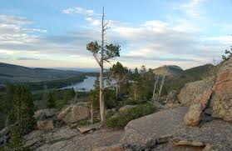
Wind and substrate (soil)
Wind can change the shape of plants, poor soils also mean plants may not grow to their normal shape and colour.

Slide 17
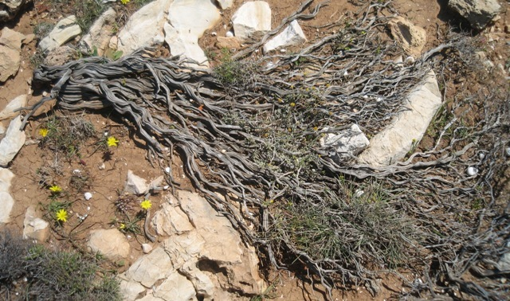
Prostrate plants
This plant is “prostrate” (= grows along the ground) because of harsh conditions. In good conditions its genes make it grow tall

Slide 18
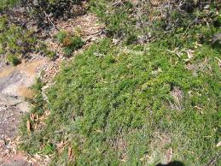
More prostrate plants
Some plants are naturally prostrate as their shape is determined by their genes

Slide 19
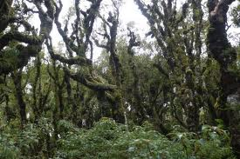
Altitude
Increasing altitude means more wind, poorer soil, colder temperature and more snow cover. These factors can stunt the growth of trees.
E.g. the “Goblin forest” on Mt Taranaki

Slide 20
On Mt Taranaki, trees like kamahi (Wr) become more stunted the higher they are on the Mt. Gradual change in phenotype over an environmental gradient is called a cline.

Slide 21
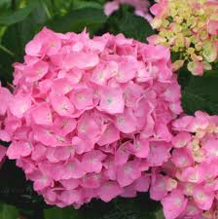
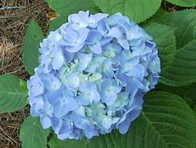
Chemical Environment
Hydrangea flowers are blue in acid soils and pink in alkaline soils

Slide 22
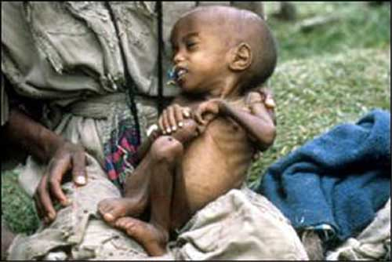
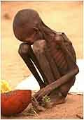
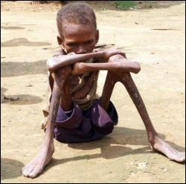
Lack of nutrients
Starvation
Without enough food, genes for growth can not be expressed

Slide 23
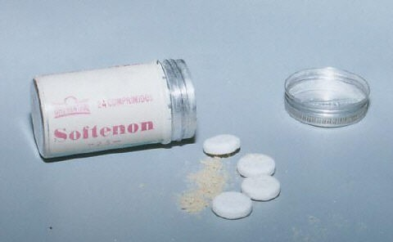
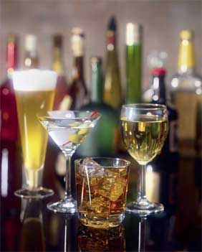
Chemicals
Drugs taken by pregnant women
E.g. Thalidamide, alcohol

Slide 24
Thalidomide
In 1958 a wonder drug was given to pregnant women for morning sickness, instead it caused death to thousands of babies worldwide and left the survivors to be born without limbs and severe deformities. The very first victim was born in Germany in 1958, which continued to damage other babies until 1962 worldwide. We were told by the medical profession that it would not be allowed to happen again.
In 1995 the drug was secretly brought back by the UK and Brazil, yet some countries are still giving the drug to pregnant women and has a result babies are still being born with missing limbs.

Slide 25
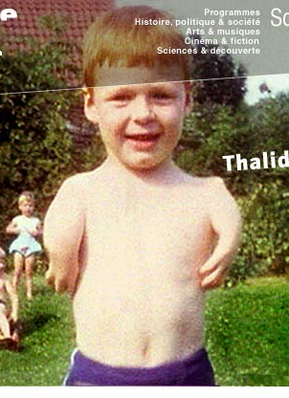
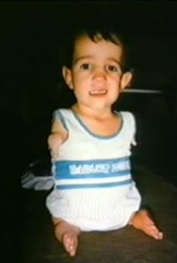
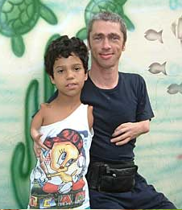
Thalidomide

Slide 26
Foetal Alcohol Syndrome
Problems Caused by Alcohol
Growth abnormalities
Cranio-facial abnormalities
Musculoskeletal abnormalities
Cardial abnormalities
Nervous system abnormalities
Neurodevelopment delay or mental deficiency
Short stature appears permanent
Learning and behavioural deficits widely variable.
Problems with Co-operation, sustained attention, comprehension, retention of information, self-control, relationships, word recall, organisational skills.

Slide 27
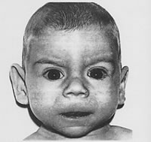
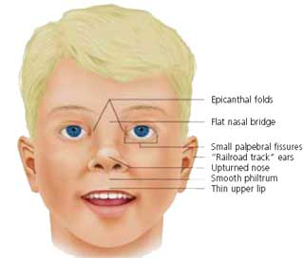
Infant with Fetal Alcohol Syndrome showing depressed nasal bridge, absent philtrum, thin upper lip, short palpebral fissures and large ears.

Slide 28
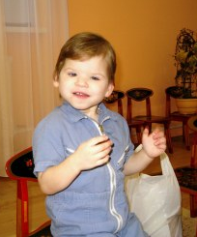
One more for the road

Slide 29
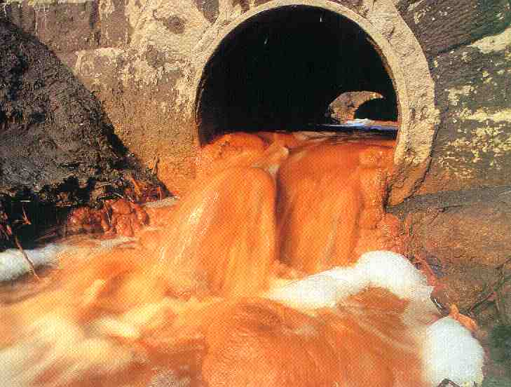
Polluting Chemicals

Slide 30
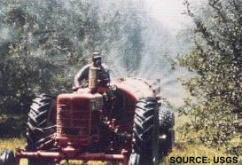

Slide 31
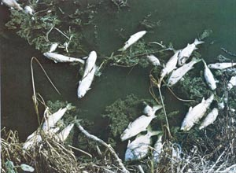

Slide 32
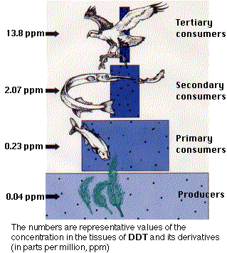
DDT
This now banned pesticide built up in food chains

Slide 33
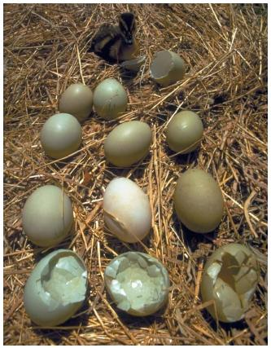
It had harmful effects such as weakened eggshells

Slide 34
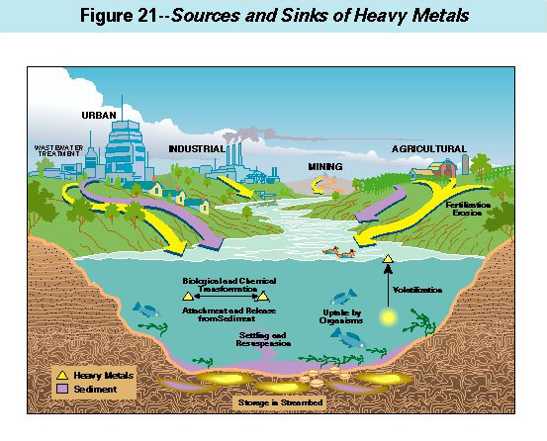

Slide 35

Heavy metals can be harmful

Slide 36
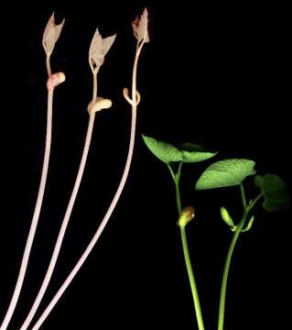
Lack of light
Etiolation of bean plants (on left)

Slide 37
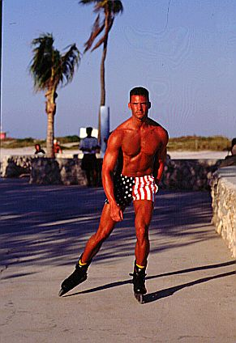
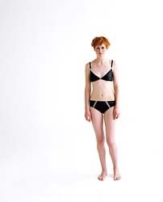
Lack of light 2
Pale vs Tanned

Slide 38
